Slide 1

Optimized Waste Collection Routing in Cities Using Ant Colony Optimization
Project Documentation

Slide 2
Topics to be Covered
The Problem Definition
Ant Colony Algorithms
Hybrid Algorithms
Algorithms Results
Use Cases for each Algorithm

Slide 3

Waste Collection Routing
The Waste Collection Routing Problem (WCRP) is a logistical and operational optimization challenge that focuses on designing the most efficient routes for vehicles to collect waste from various locations (such as households, businesses, or public bins) and transport it to disposal or processing facilities, such as landfills or recycling centers. It is a variant of the Vehicle Routing Problem (VRP), a well-known problem in operations research and combinatorial optimization, tailored specifically to the context of waste management.

Slide 4
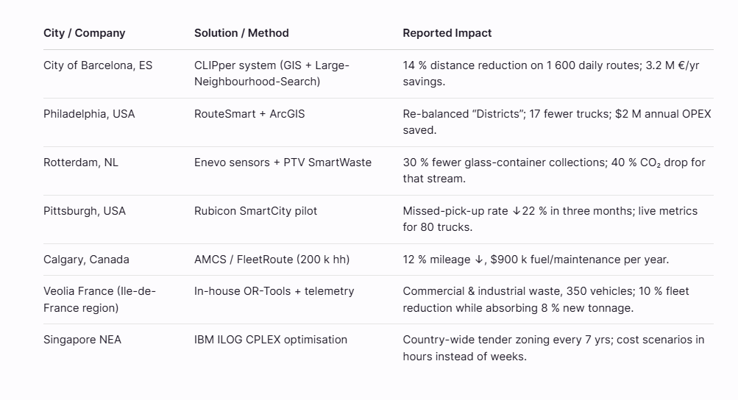
Waste Collection Routing in the Market

Slide 5
Waste Collection Routing
Problems Can be one of the following : Simulation, Modelling or Optimization.
Waste Collection Routing is an Optimization Problem.
In Optimization Problems : Model and desired Output are Known

Slide 6

Waste Collection Routing
Optimization Problems can be one of the following : Free Optimization, Constraint Satisfaction or Constrained Optimized.
Our Problem is Free Optimized.
Optimization : find the minimum route between cities
Constraints : tau (min && max) in Max-Min Algorithm.

Slide 7
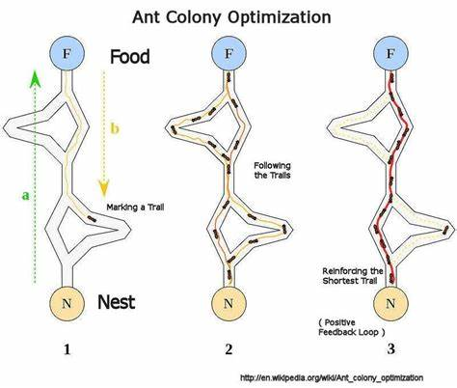
Ant Colony Optimization
Ant Colony Optimization (ACO) is a metaheuristic optimization algorithm inspired by the foraging behavior of ants in nature. It is used to solve complex combinatorial optimization problems, such as the Waste Collection Routing Problem, Traveling Salesman Problem (TSP), and other routing or scheduling challenges. ACO was first introduced by Marco Dorigo in the early 1990s as part of his doctoral research.

Slide 8
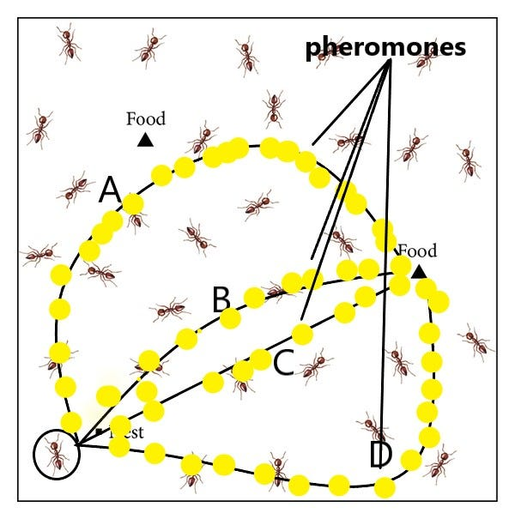
Key Components of ACO Algorithms
Graph Representation: The problem is modeled as a graph where:
Nodes represent decision points (e.g., cities in TSP or waste collection points in WCRP).
Edges represent possible connections or paths between nodes, often associated with a cost (e.g., distance or time).
Artificial Ants: These are agents that explore the graph by constructing solutions (e.g., a route) based on probabilistic decisions influenced by pheromone trails and heuristic information.
Pheromone Trails: Each edge in the graph has an associated pheromone value, which represents the desirability of choosing that path. Pheromone levels are updated based on the quality of solutions found by the ants.

Slide 9
Key Components of ACO Algorithms
Heuristic Information: Often denoted as η (eta), this represents domain-specific knowledge or a cost measure (e.g., inverse of distance between two nodes) that guides ants toward promising paths alongside pheromone trails.
Probability Rule: Ants choose their next move based on a probabilistic transition rule that balances the influence of pheromone trails (exploitation of past good solutions) and heuristic information (exploration of new possibilities)

Slide 10
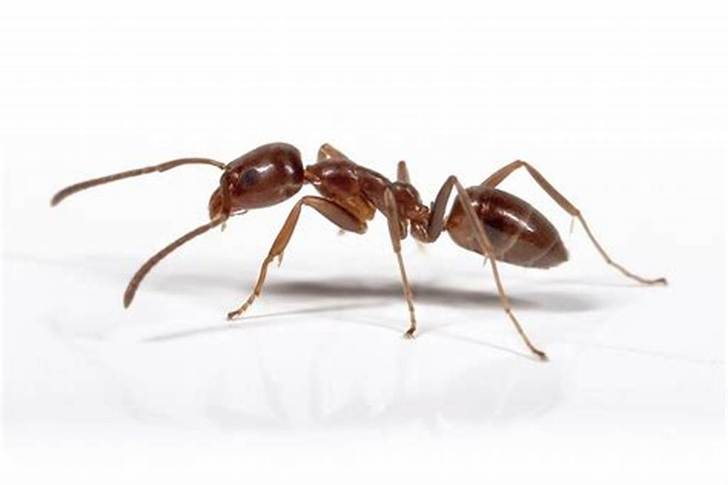
Algorithms
Ant Colony System
Max-Min Ant System
Distributed Any Colony
ACO hybrid with Genetic Algorithm
ACO hybrid with Simulated Annealing

Slide 11
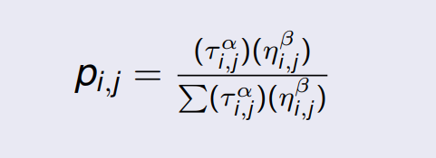
Ant Colony System
An ant will move from node i to node j with probability
where τi,j is the amount of pheromone on edge i, j
α is a parameter to control the influence of τi,j
ηi,j is the desirability of edge i, j (typically 1/di,j )
β is a parameter to control the influence of ηi,j

Slide 12

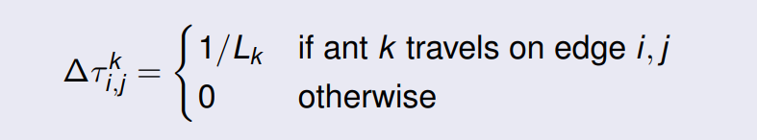
Ant Colony System
Amount of pheromone is updated according to the equation.
where τi,j is the amount of pheromone on a given edge i, j
ρ is the rate of pheromone evaporation
∆τi,j is the amount of pheromone deposited, typically given by
where Lk is the cost of the k th ant’s tour (typically length).

Slide 13
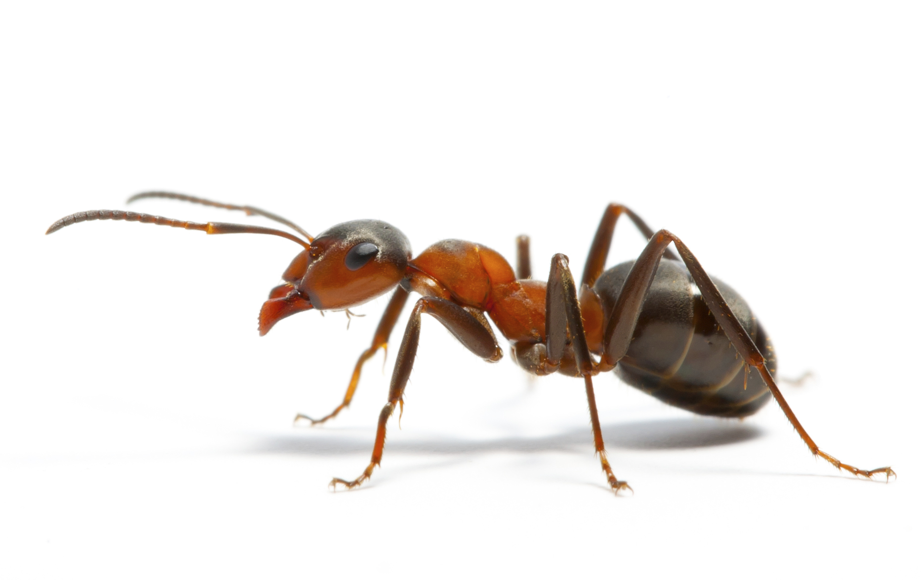
ACO System Parameters
α: Controls the influence of pheromone trails (τijτij​) on the ants' decision-making process. It determines how much ants rely on the historical "memory" of good paths stored in pheromone levels.
β: Controls the influence of the heuristic information (ηijηij​), which often represents a domain-specific measure like the inverse of distance between two nodes. It governs how much ants prioritize immediate, greedy choices based on problem-specific knowledge.
ρ (evaporation rate): Represents the rate at which pheromone trails decay over iterations. It helps prevent the algorithm from getting stuck in suboptimal solutions by reducing the influence of old pheromone trails.
Q: A constant used in the pheromone deposit rule, often related to the amount of pheromone an ant deposits after completing a solution. It scales the reinforcement of good paths based on solution quality (e.g., inversely proportional to the cost of the route).

Slide 14
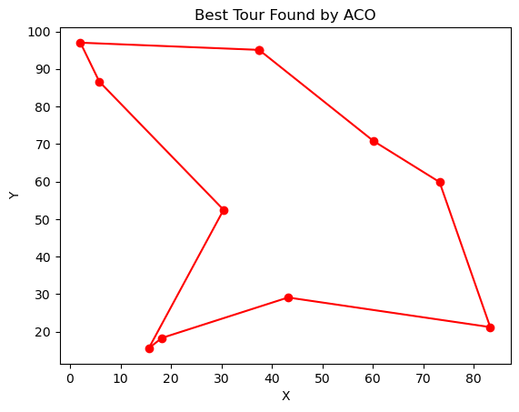
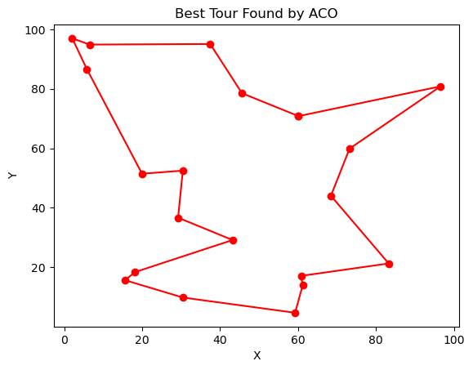
ACO System Result

Slide 15
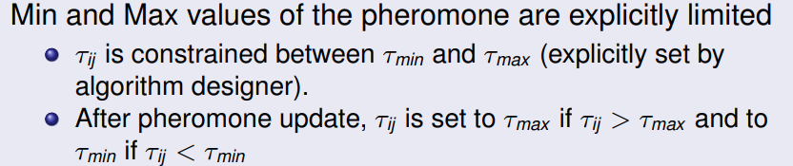
Max-Min Ant System
MMAS enhances exploration and exploitation balance by enforcing bounds on pheromone levels, ensuring that no single path becomes overwhelmingly dominant too early in the search process. Below is a detailed explanation of the MMAS algorithm, including its key features, steps, and relevance to optimization problems like the Waste Collection Routing Problem.

Slide 16
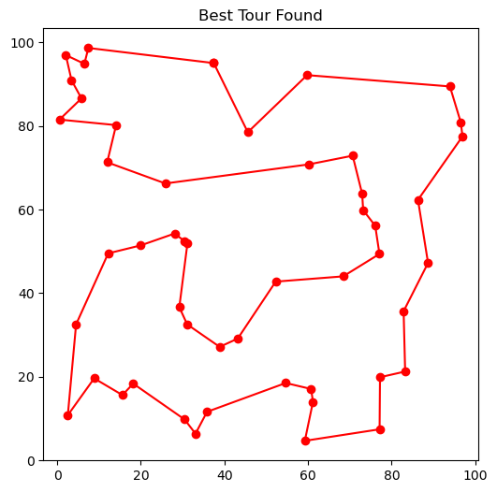
Max-Min System Result

Slide 17
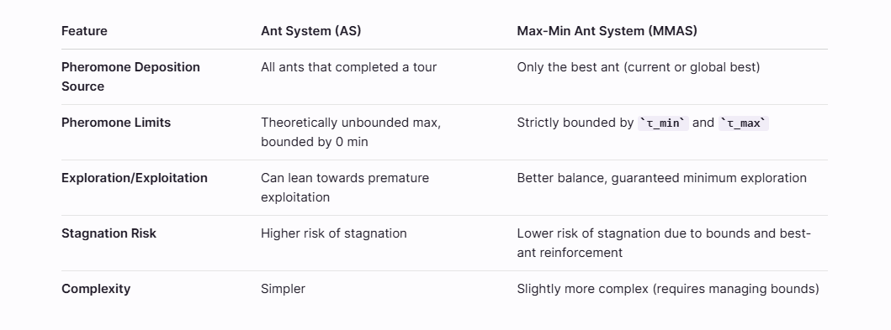
ACO System vs Max-Min ACO

Slide 18
Distributed ACO
Distributed Ant Colony Optimization uses multiple ant colonies that work independently with periodic information exchange to improve solution quality and convergence speed.
This approach combines the exploratory power of independent search with the exploitation of shared good solutions, often leading to better results than single-colony approaches.

Slide 19
Distributed ACO Parameters
num_colonies: Number of ant colonies (default: 4)
ants_per_colony: Number of ants in each colony (default: 10)
alpha, beta, rho, q: Same as for Discrete ACO
exchange_freq: Frequency of information exchange between colonies (default: 10 iterations)
exchange_strategy: Strategy for information exchange ('best' or 'random') (default: 'random')
max_iterations: Maximum number of iterations (default: 100)
seed: Random seed for reproducibility (default: 100)

Slide 20
Specialized Distributed Algo Parameters
Number of Colonies
Effect: Controls degree of parallelism
Increasing: More colonies increase diversity but require more resources
Decreasing: Fewer colonies reduce computational overhead but might reduce solution diversity
Recommended Range: 2 to 8
Optimal Value: Often around 4 for balanced performance

Slide 21
Specialized Distributed Algo Parameters
Exchange Frequency
Effect: Controls how often colonies share information
Increasing: Higher frequency leads to more rapid information sharing but less independent exploration
Decreasing: Lower frequency allows more independent exploration but slower information propagation
Recommended Range: Every 5-20 iterations
Optimal Value: Often around 10 iterations for balanced performance

Slide 22

Distributed ACO use cases
Large-Scale Logistics and Transportation
Dynamic and Online Routing (e.g., in Communication Networks or Traffic Systems)
Large-Scale Scheduling

Slide 23
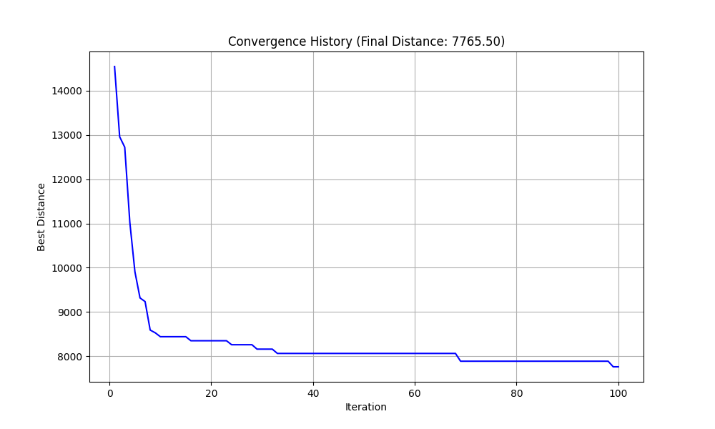
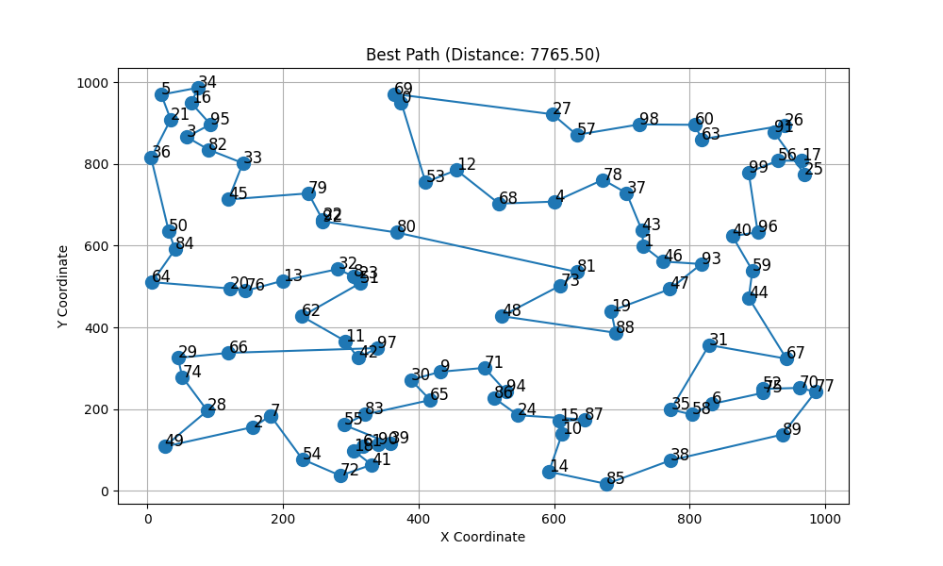
Distributed ACO Result

Slide 24
Compare
ACO System
Distributed

Slide 25
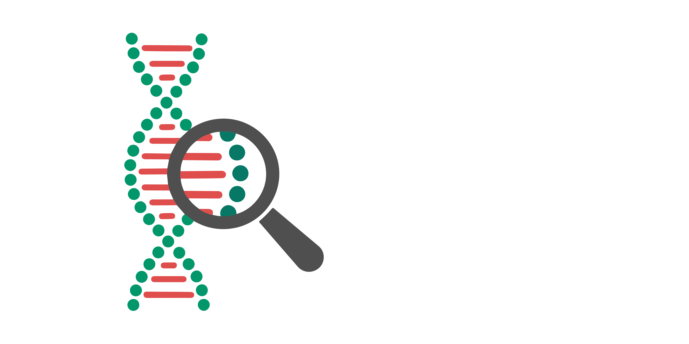
ACO hybrid with Genetic Algorithm
This algorithm follows the standard Ant Colony Optimization (ACO). In addition to the standard ACO steps, after a predefined number of iterations, the top-performing ants (i.e., those with the shortest tours) are selected for genetic operations. Specifically, Order Crossover and swap mutation (based on a given mutation rate) are applied to generate new candidate solutions. These offspring are then compared to the worst-performing ants in the colony. If any offspring have better tour lengths, they replace the corresponding worst ants, enhancing solution quality and promoting population diversity

Slide 26
Why ACO with Genetic
ACO
Genetic
Excellent at exploiting positive feedback to reinforce good paths or components of solutions through the pheromone mechanism.
Can converge relatively quickly by focusing search on promising areas based on pheromone.
Excellent at exploring the search space and maintaining diversity within a population of solutions.
Operators like crossover can effectively combine good characteristics (sub-paths, assignments) from different parent solutions.
Mutation helps introduce new variations and can potentially escape local optima.

Slide 27
ACO hybrid with Genetic Algorithm
num_selected: 10 (Number of top ants selected from the ACO population to be used as parents in select_top_ants)
num_children: 10 (Number of new children tours generated from the selected parents in generate_children)
mutation_rate: 0.1 (Probability that a mutation occurs on a child tour after crossover in generate_children)
Replacement Strategy (Implicit): The code uses replace_worst_ants, implying that the generated children replace the worst-performing ants in the current population.

Slide 28
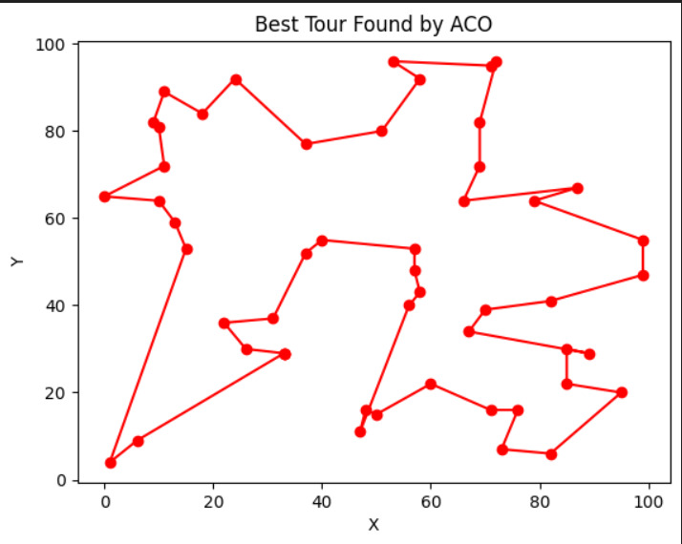
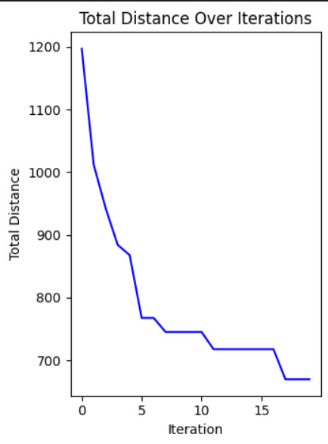
ACO hybrid with Genetic Algorithm

Slide 29
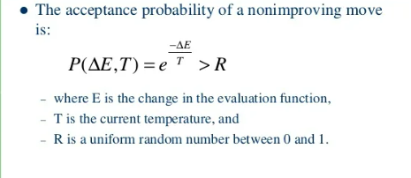
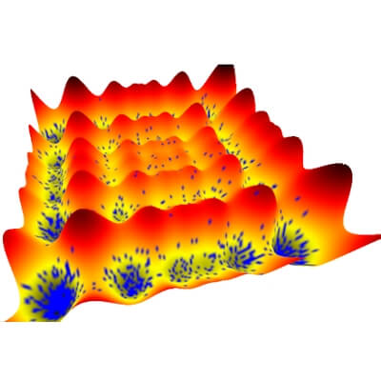
ACO hybrid with Simulated Annealing
This algorithm integrates Ant Colony Optimization (ACO) with Simulated Annealing (SA). ACO is used as the main framework, where artificial ants iteratively construct solutions based on pheromone levels and heuristic desirability (distance-based). After each iteration, pheromones are updated to reinforce better solutions. To enhance local search and escape local minima, the best ant’s tour is refined using Simulated Annealing. SA perturbs the solution by swapping two cities and probabilistically accepts worse solutions based on a temperature schedule, encouraging exploration. If the SA-refined tour is better than the original, it replaces it. This hybrid approach balances global search from ACO with local refinement from SA, improving convergence and solution quality over time.

Slide 30
ACO hybrid with Simulated Annealing
ACO
Simulated Annealing
Good at constructing solutions step-by-step (e.g., building a tour by adding cities sequentially).
Leverages positive feedback (pheromone) to guide the search towards promising paths based on the collective experience of multiple "ants".
Good at local search and refinement of an existing solution. It iteratively makes small changes (moves) to a single solution.
Has a mechanism (probabilistic acceptance of worse moves based on temperature) to escape local optima.

Slide 31
ACO hybrid with Simulated Annealing
T_start: 1000 (Starting temperature for the annealing process)
T_end: 1 (Ending temperature for the annealing process)
alpha (Cooling Rate): 0.995 (Factor by which the temperature is multiplied in each cooling step)
max_iter: 100 (This parameter is defined in the function signature but is not used within the function body. The cooling is controlled by T > T_end and the alpha factor.)

Slide 32
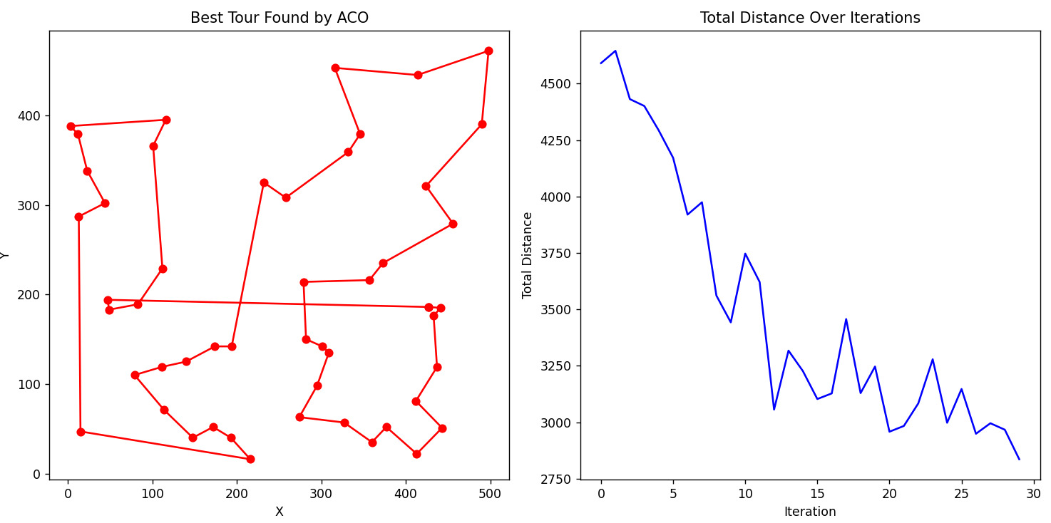
ACO hybrid with Simulated Annealing

Slide 33
Development Tools
Programming with Python
Numerical Computing with NumPy
Graphical User-Interface with Tkinter
Jupiter Notebooks
Visual Studio Code

Slide 34
References
1. M. Dorigo, M. Birattari, T. Stützle, “Ant Colony Optimization– Artificial Ants as a Computational Intelligence Technique”, IEEE Computational Intelligence Magazine,2006
2. M. Dorigo K. Socha, “An Introduction to Ant Colony Optimization”, T. F. Gonzalez, Approximation Algorithms and Metaheuristics, CRC Press, 2007
3. M. Dorigo T. Stützle, “The Ant Colony Optimization Metaheuristic: Algorithms, Applications, and Advances”, Handbook of Metaheuristics, 2002
4. A hybrid optimization algorithm based on genetic algorithm and ant colony optimization Zainudin Zukhri1 and Irving Vitra PaputunganFaculty of Industrial Technology, Islamic University of Indonesia,Jl. Kaliurang KM 14.4 Yogyakarta Indonesi
5. Hybrid Algorithm Based on Ant Colony Optimization and Simulated Annealing Applied to the Dynamic Traveling Salesman ProblemPetr Stodola, Karel Michenka, Jan Nohel and Marian Rybansk

